Slide 1
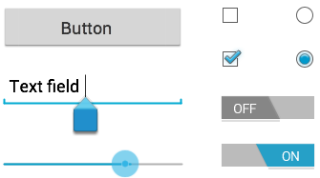
UI Control
Prepare By: You Tithrottanak

Slide 2
TextView
TextView displays text to the user.
<TextView
android:layout_width="wrap_content"
android:layout_height="wrap_content"
android:text="Hello"/>
Prepare By: You Tithrottanak

Slide 3
TextView
Attribute | Description
android:id | This is the ID which uniquely identifies the control.
android:text | Text to display.
android:textColor | Text color. May be a color value, in the form of "#rgb", "#argb", "#rrggbb", or "#aarrggbb".
android:textColorHighlight | Color of the text selection highlight.
android:textSize | Size of the text. Recommended dimension type for text is "sp" for scaled-pixels (example: 15sp).
android:textStyle | Style (bold, italic, bolditalic) for the text. You can use or more of the following values separated by '|‘ normal - 0 bold - 1 italic - 2
android:typeface | Typeface (normal, sans, serif, monospace) for the text. You can use or more of the following values separated by '|' normal - 0 sans - 1 serif - 2 monospace - 3
Prepare By: You Tithrottanak

Slide 4
EditText
EditText is textbox that allow user to input text.
<EditText
android:layout_width="match_parent"
android:layout_height="wrap_content"
android:id="@+id/editText"/>
Prepare By: You Tithrottanak

Slide 5
EditText
Attribute | Description
android:autoText | If set, specifies that this TextView has a textual input method and automatically corrects some common spelling errors.
android:drawableBottom | This is the drawable to be drawn below the text.
android:drawableRight | This is the drawable to be drawn to the right of the text.
android:hint | Hint text to display when the text is empty.
android:text | This is the Text to display.
android:inputType | The type of data being placed in a text field. Phone, Date, Time, Number, Password etc.
Prepare By: You Tithrottanak

Slide 6
EditText
How to get text in code.
After setContentView(R.layout.activity_main);
EditText eText = (EditText) findViewById(R.id.edittext);
So You can get :
String str = eText.getText().toString();
And you can set:
eText.setText(“Hello”);
Prepare By: You Tithrottanak

Slide 7
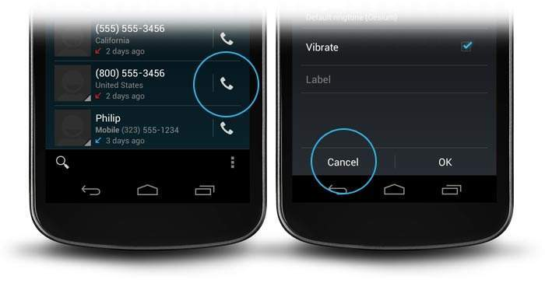
Button
A Button is a Push-button which can be pressed, or clicked, by the user to perform an action.
<Button
android:layout_width="wrap_content"
android:layout_height="wrap_content"
android:id="@+id/button"
android:text="Login"/>
Prepare By: You Tithrottanak

Slide 8
Button
Attribute | Description
android:background | This is a drawable to use as the background.
android:contentDescription | This defines text that briefly describes content of the view.
android:id | This supplies an identifier name for this view,
android:onClick | This is the name of the method in this View's context to invoke when the view is clicked.
android:visibility | This controls the initial visibility of the view.
Prepare By: You Tithrottanak

Slide 9
Button: How to get action click?
Button b1=(Button)findViewById(R.id.button);
b1.setOnClickListener(new View.OnClickListener() {
@Override
public void onClick(View v) {
//write code here.
}
});
Prepare By: You Tithrottanak

Slide 10
Button: Example 1
Create Empty Project Two Activity Class
Then in layout create TextView, EditText and Button
When User press button Show Hello x that x is text that you get from EditText By using
Toast.makeText(Context, String, Length ).show();
Ex: Toast.makeText(getApplicationContext(), “Hello Nak!”, Toast.LENGTH_LONG).show();
Prepare By: You Tithrottanak

Slide 11
Button: Example 2
Create Two Activity Class
Then in layout in each layout has only one button
First Activity Button Text is Next
Second Activity Button Text is Back
When User press button on FirstActivity so you call SecondActivity
When User press button on SecondActivity so you call FirstActivity
Prepare By: You Tithrottanak

Slide 12
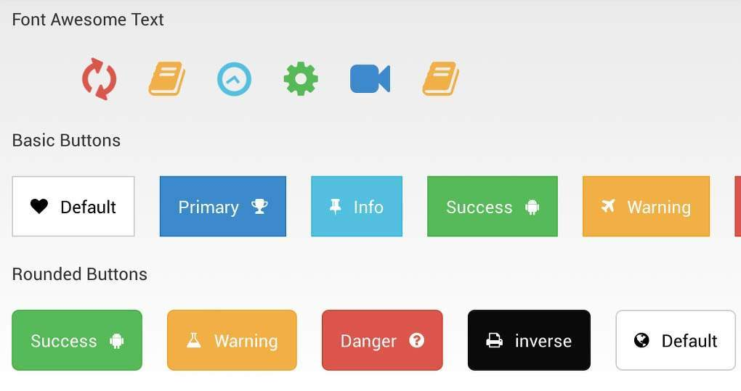
ImageButton
<ImageButton
android:layout_width="wrap_content"
android:layout_height="wrap_content"
android:id="@+id/imageButton“
android:src="@drawable/abc"/>
Prepare By: You Tithrottanak

Slide 13
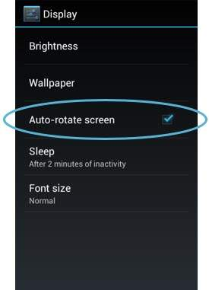
CheckBox
<CheckBox
android:id="@+id/checkBox1"
android:layout_width="wrap_content"
android:layout_height="wrap_content" android:layout_above="@+id/checkBox1"/>
Method:
isChecked() : to retrieve whether checkbox is check or not
setChecked(Boolean v) : to set value to checkbox
Prepare By: You Tithrottanak

Slide 14
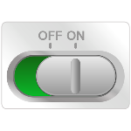
ToggleButton
<ToggleButton
android:layout_width="wrap_content"
android:layout_height="wrap_content"
android:text="On"
android:id="@+id/toggleButton"
android:checked="true"/>
Attribute | Description
android:textOff | This is the text for the button when it is not checked.
android:textOn | This is the text for the button when it is checked.
Prepare By: You Tithrottanak

Slide 15
RadioGroup
<RadioGroup
android:layout_width="fill_parent"
android:layout_height="90dp" android:id="@+id/radioGroup“>
< RadioGroup>
Prepare By: You Tithrottanak

Slide 16

RadioButton
<RadioGroup
android:layout_width="fill_parent"
android:layout_height="fill_parent“
android:id="@+id/radioGroup“>
<RadioButton
android:layout_width="142dp"
android:layout_height="wrap_content"
android:text=“Male"
android:id="@+id/radioButton“
android:checked="false"/>
<RadioButton
android:layout_width="wrap_content"
android:layout_height="wrap_content"
android:text=“Female"
android:id="@+id/radioButton2“
android:checked="false“
android:textSize="25dp" />
</RadioGroup>
RadioGroup rg1 = (RadioGroup) findViewById(R.id.radioGroup);
int selected=rg1.getCheckedRadioButtonId(); rb1=(RadioButton)findViewById(selected);
-- rb.getText(): for get text what radio isSelected
Prepare By: You Tithrottanak

Slide 17
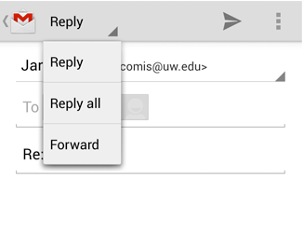
Spinner
<Spinner
android:id="@+id/spinner"
android:layout_width="fill_parent"
android:layout_height="wrap_content"
android:prompt="@string/spinner_title"/>
Prepare By: You Tithrottanak

Slide 18
Spinner
// Spinner element
Spinner spinner = (Spinner) findViewById(R.id.spinner);
// Spinner click listener
spinner.setOnItemSelectedListener(this);
// Spinner Drop down elements
List<String> categories = new ArrayList<String>();
categories.add("Automobile");
categories.add("Business Services");
categories.add("Computers");
categories.add("Education");
categories.add("Personal");
categories.add("Travel");
Prepare By: You Tithrottanak

Slide 19
Spinner
// Creating adapter for spinner
ArrayAdapter<String> dataAdapter = new ArrayAdapter<String>(this, android.R.layout.simple_spinner_item, categories);
// Drop down layout style - list view with radio button
dataAdapter.setDropDownViewResource(android.R.layout.simple_spinner_dropdown_item);
// attaching data adapter to spinner
spinner.setAdapter(dataAdapter);
@Override
public void onItemSelected(AdapterView<?> parent, View view, int position, long id) {
// On selecting a spinner item
String item = parent.getItemAtPosition(position).toString();
// Showing selected spinner item
Toast.makeText(parent.getContext(), "Selected: " + item, Toast.LENGTH_LONG).show();
}
Prepare By: You Tithrottanak

